Slide 1
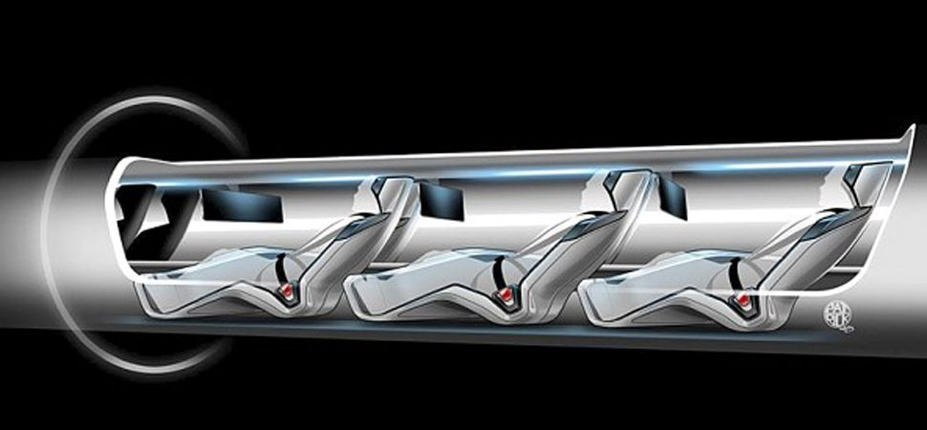
The Hyperloop
The Future of Transportation
PRESENTED BY :
Shradha Patil, Gouri Huddar, Omprakash Jat, Smruti bhandiwad

Slide 2
Contents
Addressing the situation
Introduction to the hyperloop system
The Concept
Components
Working principle
Application
Comparison
Safety & Advantages
Limitations
Conclusion
References
Q&A

Slide 3
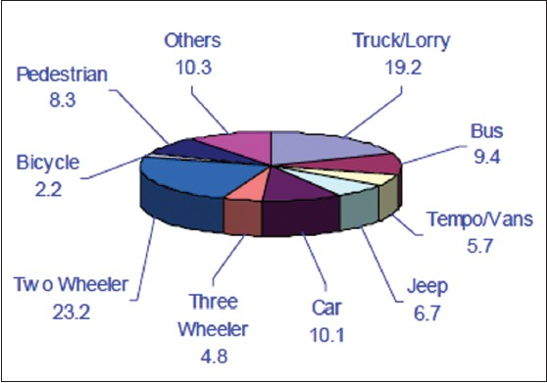
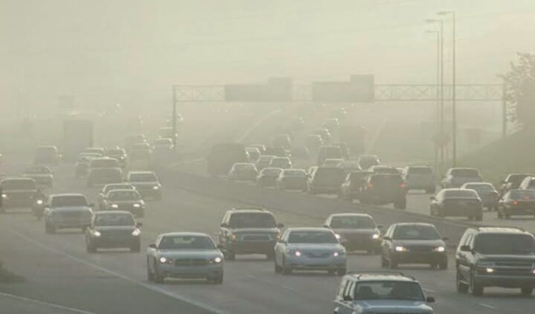
Need for the Technology:
1.Road (inexpensive, slow, usually not environmentally sound)
2. Air (expensive, fast, not environmentally sound)
3. Rail (expensive, slow, often environmentally sound)

Slide 4
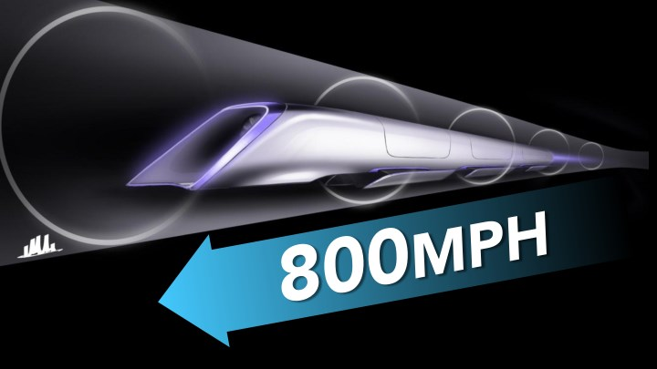
Introduction To The Hyperloop System
It is the new form of transportation system between long distances.
Hyperloop consists of a low pressured tube with capsules that are transported at both high and low speeds throughout the length of the tube.
It is a high speed transporting at a speed of 800 mph which is twice the speed of a commercial plane.
Oh That’s Fast!!!

Slide 5
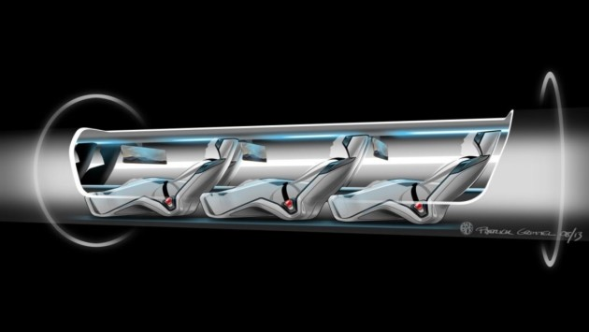
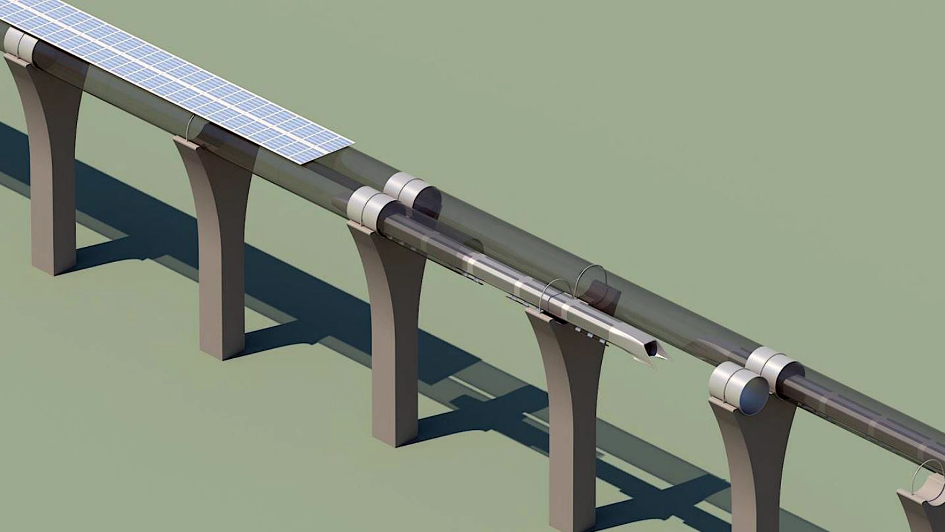
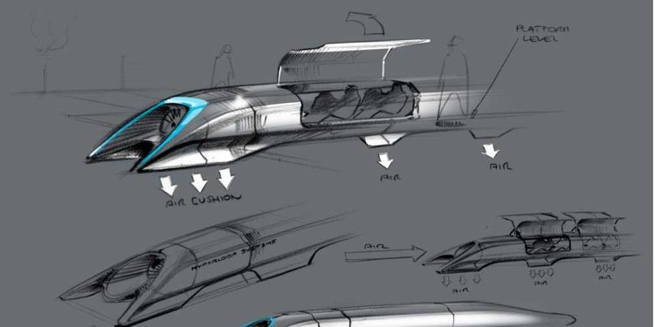
Hyperloop’s
Conceptual Design

Slide 6
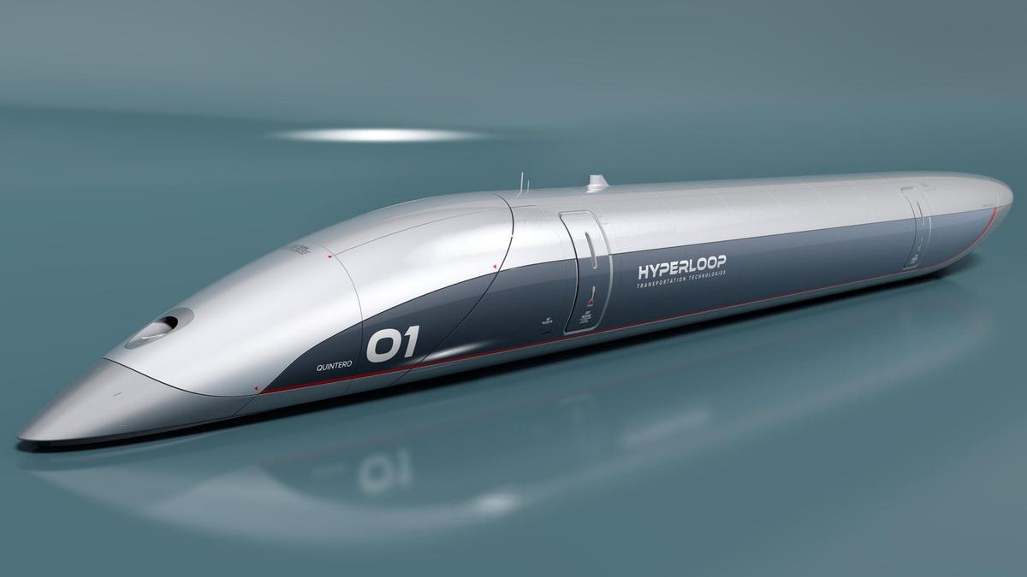
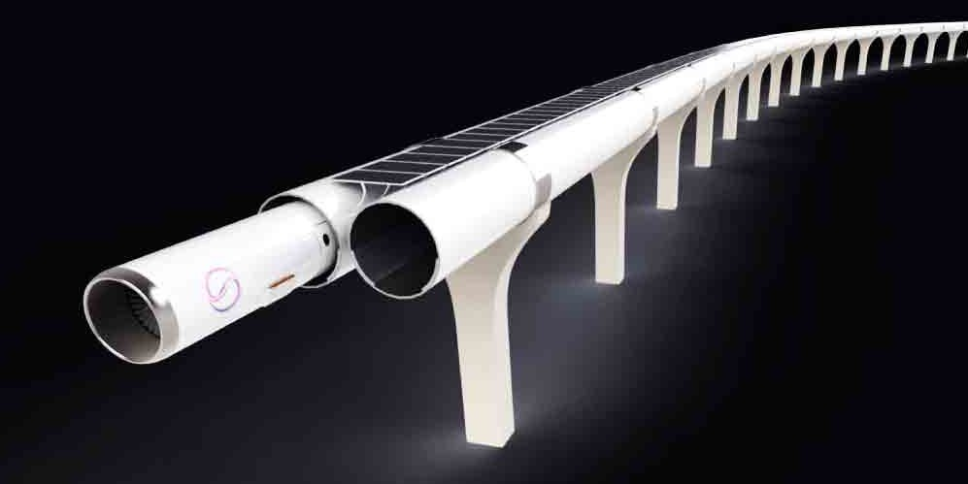
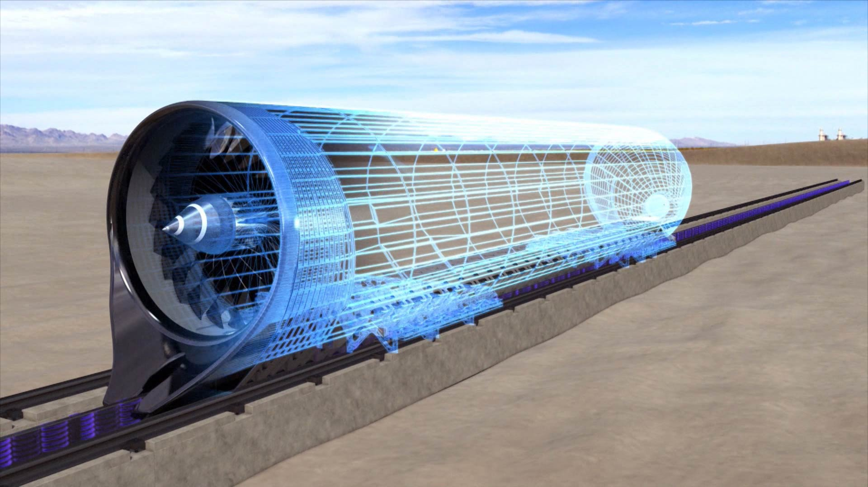
Components of Hyperloop
1. CAPSULE
2. TUBE
3. PROPULSION

Slide 7
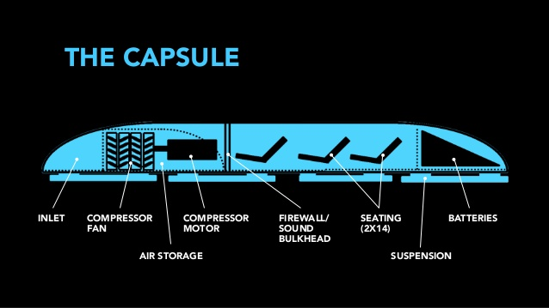
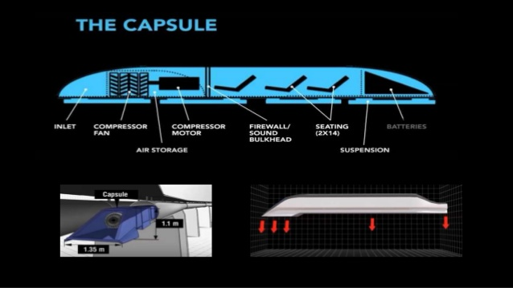

Slide 8

CAPSULE
Sealed capsules carrying 28 passengers each that travel along the interior of the tube depart on average every 2 minutes from Los Angeles or San Francisco (up to every 30 seconds during peak usage hours). Page 10
A larger system has also been sized that allows transport of 3 full size automobiles with passengers to travel in the capsule.
The capsules are separated within the tube by approximately 23 miles (37 km) on average during operation.
d. The capsules are supported via air bearings that operate using a compressed air reservoir and aerodynamic lift.

Slide 9
Compressor
The onboard compressor allows the capsule to traverse the relatively narrow tube without choking flow that travels between the capsule and tube wall.
It also provides air to air bearing that support the weight of the capsule throughout the journey.

Slide 10
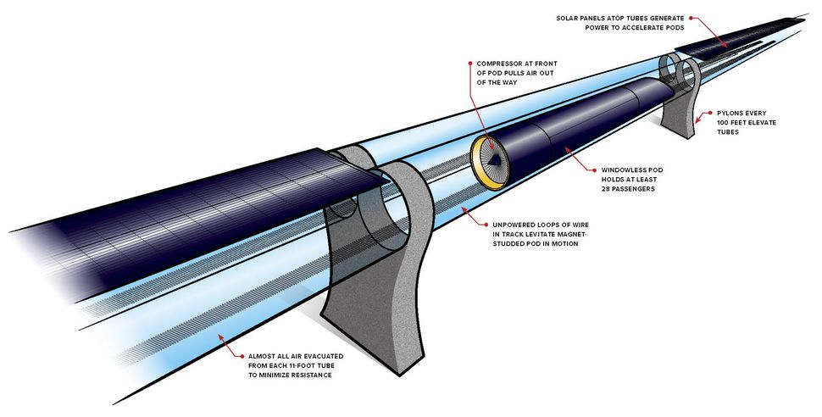
The Tube
The tube is made of steel supported by pillars kept 30m apart from each other & built using reinforced concrete.
Solar arrays will cover the top of the tube in order to provide power to the system.

Slide 11
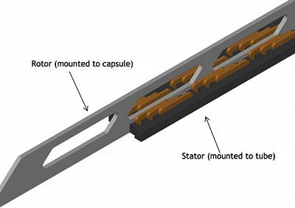
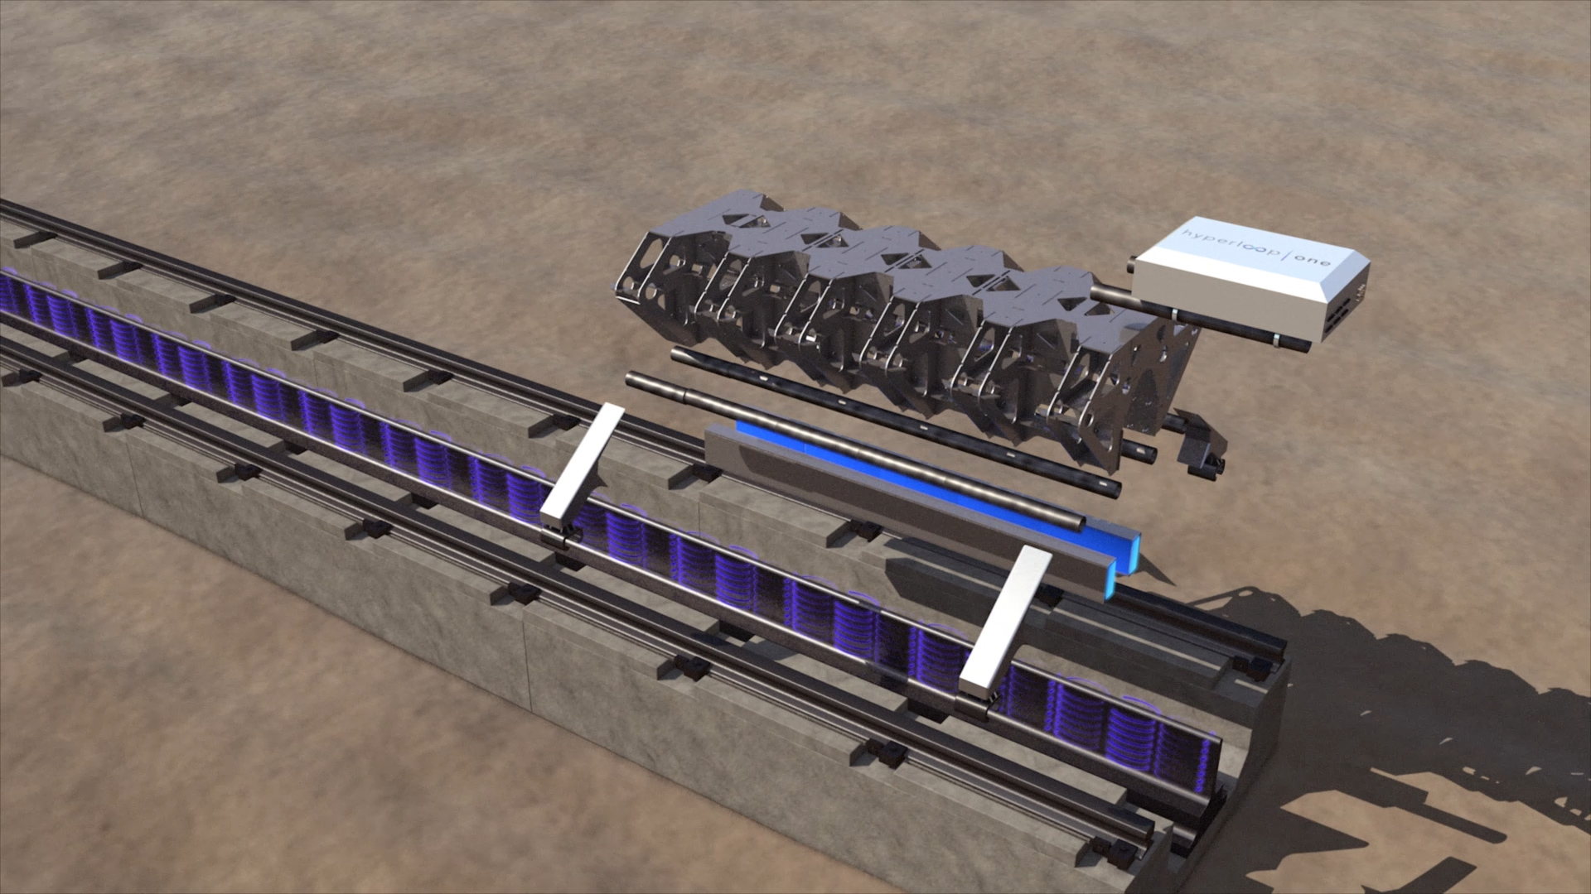
Propulsions
Linear accelerators are constructed along the length of the tube.
Stators are located on the capsules to transfer momentum to the capsules.
Capsules are accelerated by linear magnetic induction and decelerated by regenerative braking similar to magnetic levitation trains.

Slide 12
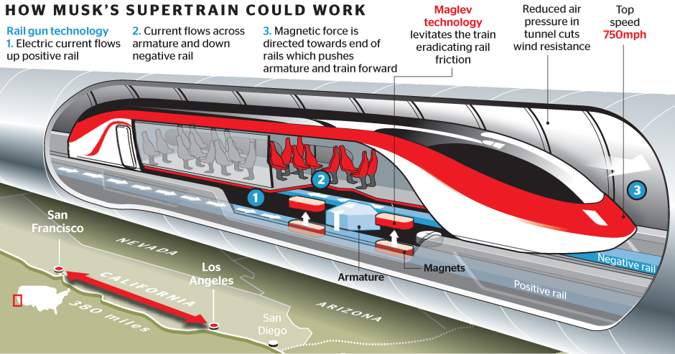
Working Principle

Slide 13
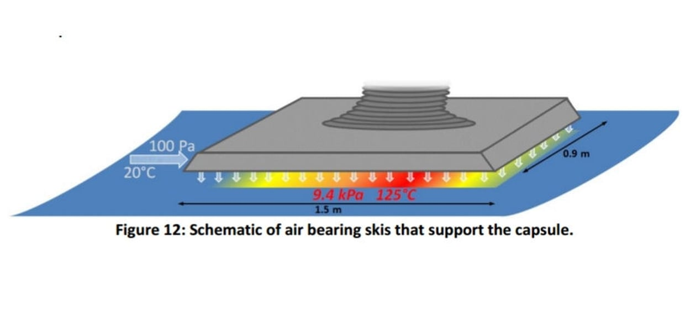
Suspension System
Suspending the capsule.
Magnetic levitation.
An alternative to the above these is an air bearing suspension.
Non-linear reaction resulting in large restoring pressures.
The increased pressure pushes the ski away from the wall, allowing it to return to its normal ride height.

Slide 14
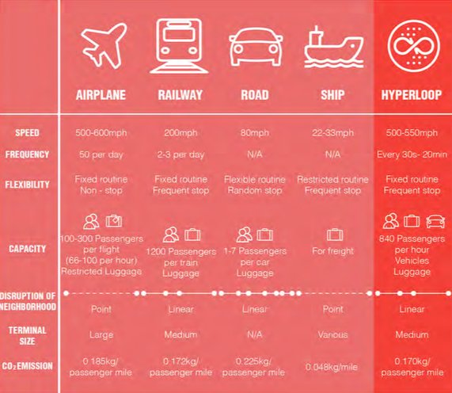
Comparison

Slide 15
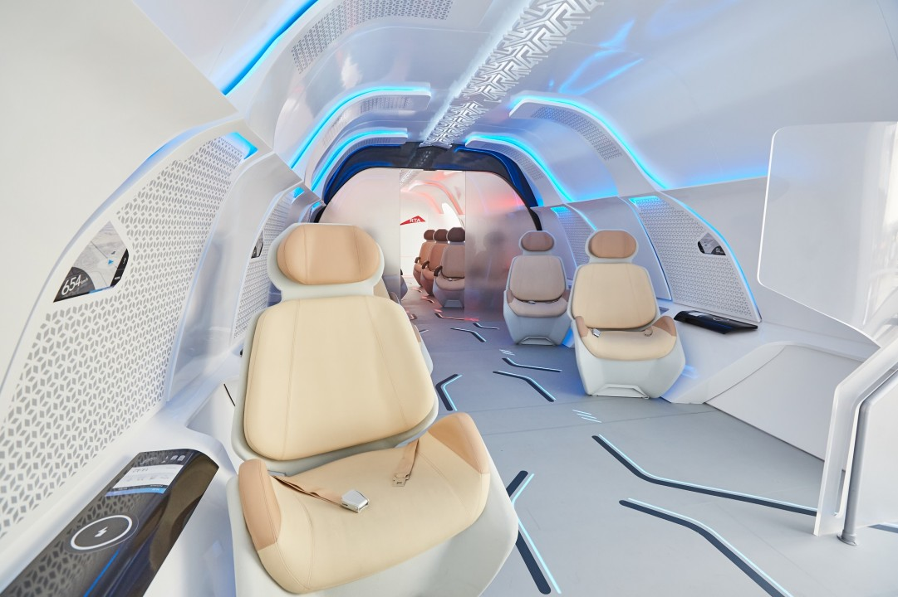
Safety & Advantages
Design of hyperloop has been considered from start with safety in minds. It’s a single system that incorporates the vehicle, the propulsion system, energy management, timing and route.
Interior safety :
The seats conform well to the body to maintain comfort during high speed accelerations.

Slide 16
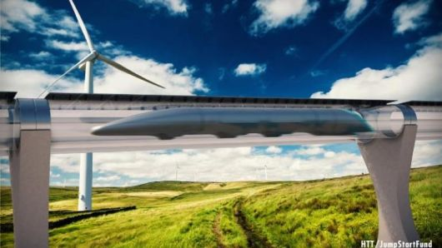
Immune to weather:
It is immune to any kind of weather changes as it is in the tube.
Resistant to earthquake:
The tube length is built with necessary flexibility to withstand the earthquake. In case of sudden stop mechanical braking system would be activated.

Slide 17
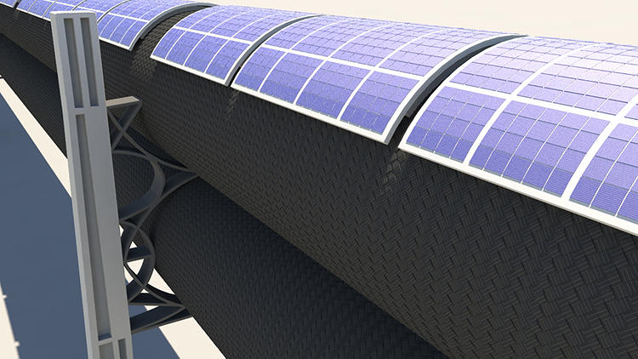
Sustainable self powering
It would use solar energy for powering itself. The solar panels are placed on the tube.
Decreases the frictional losses that occur at subsonic speed

Slide 18
Low cost at this kind of speed
Almost no pollution
Decrease the traffic

Slide 19
Limitations
Initial cost of investment to have the system in place is very high. The long vacuum chamber manufacturing requires more technical skills. Moreover, this is costly and also risky to maintain.
It has very high risk to life when something wrong happens to the system.
No sharp curves or abrupt height changes in the route
Potential for rapid decompression of the tube or passenger space
Vibration and jostling caused by high speeds
People will not be able to move freely during travel (no bathroom?)

Slide 20
Hyperloop Research Programs and Companies:
TUM Hyperloop:
In 2015 a student initiative was founded at the Technical University of Munich (TUM) to develop and build prototypes for the SpaceX Hyperloop Pod Competitions.
Virgin Hyperloop:
Virgin hyperloop successfully completed the first-ever human trial in the hyperloop pod at the DevLoop test facility in the US, where the company has previously run over 400 un-occupied tests.
Hyperloop One:
On July 29, 2017, Hyperloop One completed phase 2, after its pod travelled nearly the full distance of the 500-metre DevLoop track in the Nevada desert

Slide 21
Conclusive Discussion
As it has a number of advantages it will be very helpful for transport public as well as goods in a very short time and also in low cost.
It is a new concept so some future work will be required for implementing this project.
There are some technical as well as governmental challenges that have to be overcome and resolved.
This 5th mode of transportation will definitely enhance present day transportation system and improve daily life in a bigger way.

Slide 22
References
1. Tesla’s report on hyperloop back in 2013
https://www.tesla.com/sites/default/files/blog_images/hyperloop-alpha.pdf
2. Hyperloop Wikipedia
https://en.wikipedia.org/wiki/Hyperloop
3. TUM Hyperloop
https://tumhyperloop.de/about-hyperloop/
4. Virgin hyperloop
https://virginhyperloop.com/

Slide 23
T H A N K Y O U

